Slide 1
Chapter 5 - Strings, Procedures and Macros from Microprocessors and Interfacing by Douglas Hall

Slide 2
Objective
At the conclusion of this chapter you will be able to:
Use 8086 string manipulation instructions to perform a variety of operations on a sequence of data words in the memory.
Describe how a stack is initialize and used in 8086 assembly language program which call procedures.
Write an 8086 assembly language program which calls a near procedure.
Write an 8086 assembly language program which calls a far procedure.
Write, assemble, link and run a program which consists of more than one module.
Write and use an assembler macro.

Slide 3
Outline
The 8086 String instructions
  Moving a String
  Using compare string byte to check password
Writing and using procedures
  The CALL and RET instructions
  The 8086 Stack
  Using PUSH and POP
  Passing parameters to and from procedures
  Writing and debugging program containing procedures
  Reentrant and Recursive procedures
  Writing and Calling Far procedures
  Accessing a procedure
Writing and using Assembler Macros
  Comparison Macros and Procedures
  Defining and calling a Macro without parameters
  Passing parameters to Macros

Slide 4
The 8086 String instructions
A string is the series of bytes stored in successive memory locations.
Word processor or text editor programs can be used to create strings.
These programs have facility to search through the text.

Slide 5
Moving a String(contd.)
Definition:
  You have a string of ASCII characters in successive memory locations in data segment, and you want to move the string to some new location in the data segment.
Basic pseudo code:
REPEAT
MOVE BYTE FROM SOURCE STRING
TO DESTINATION STRING
UNTIL ALL BYTES MOVED

Slide 6
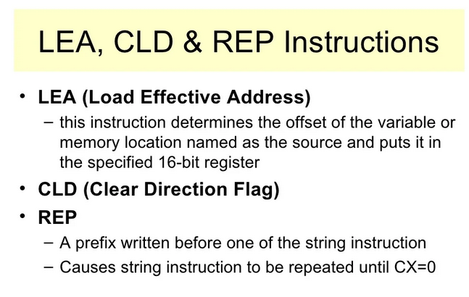

Slide 7
Moving a String(contd.)
The basic pseudo code doesn’t help much in understanding how the algorithm will be implemented.
Expanded code:
INITIALIZE SOURCE POINTER, SI
INITIALIZE DESTINATION POINTER, DI
INITIALIZE COUNTER, CX
REPEAT
COPY BYTE FROM SOURCE TO DESTINATION
INCREMENT SOURCE POINTER
INCREMENT DESTINATION POINTER
DECREMENT COUNTER
UNTIL COUNTER=0

Slide 8
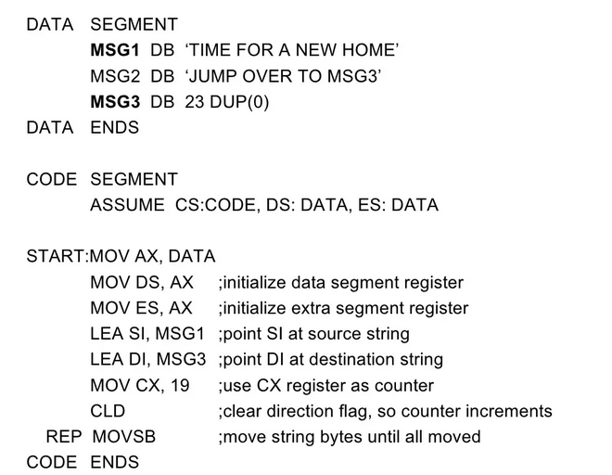

Slide 9
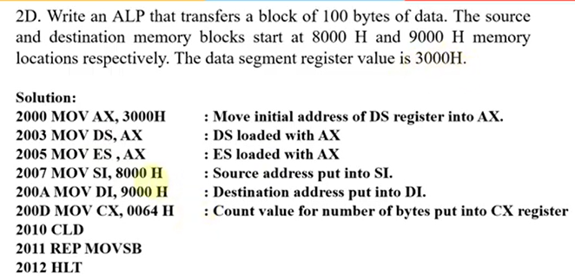

Slide 10
Using compare string byte to check password(contd.)
Definition:
  We want to compare a user entered password to the correct password stored in the memory. If the passwords do not match we want to sound an alarm and If the passwords matches we will allow access to computer for that user.
Need:
  REPEAT-UNTIL
  Compare String instruction CMPS

Slide 11
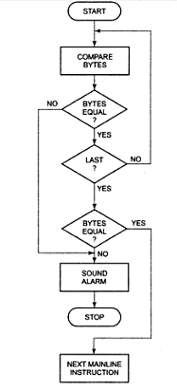
Using compare string byte to check password-flowchart →

Slide 12
Using compare string byte to check password - Code
Code:
INITIALIZE PORT DEVICE FOR OUTPUT
INTIALIZE SOURCE POINTER-SI
INITALIZE DESTINATION POINTER-DI
INITIALIZE COUNTER-CX
REPEAT
COMPARE SOURCE BYTE WITH DESTINATION BYTE
INCREMENT SOURCE POINTER
INCREMENT DESTINATION POINTER
DECREMENT COUNTER
UNTIL (STRING BYTES NOT EQUAL) OR (CX=0)
IF STRING BYTES NOT EQUAL THEN
SOUND ALARM
STOP
ELSE DO NEXT MAINLINE INSTRUCTION

Slide 13


Slide 14
Writing and using procedures
• Avoid writing the same sequence of instruction again and again.
• Write it in a separate subprogram and call that subprogram whenever necessary.
• For that CALL instruction is used.

Slide 15
The CALL and RET instructions(contd.)
The CALL Instruction:
Stores the address of the next instruction to be executed after the CALL instruction to stack. This address is called as the return address.
Then it changes the content of the instruction pointer register and in some cases the content of the code segment register to contain the starting address of the procedure.

Slide 16
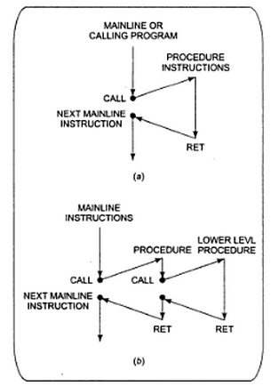
The CALL and RET instructions(contd.)
Chart for CALL and RET instruction →
Single Procedure
Nested Procedure

Slide 17
The CALL and RET instructions(contd.)
Types of CALL instructions:
DIRECT WITHIN-SEGMENT NEAR CALL: produce the starting address of the procedure by adding a 16-bit signed displacement to the contents of the instruction pointer.
INDIRECT WITHIN-SEGMENT NEAR CALL: the instruction pointer is replaced with the 16-bit value stored in the register or memory location.
THE DIRECT INTERSEGMENT FAR CALL: used when the called procedure is in different segment. The new value of the instruction pointer is written as bytes 2 and 3 of the instruction code. The low byte of the new IP value is written before the high byte.
THE INDIRECT INTERSEGMENT FAR CALL: replaces the instruction pointer and the contents of the segment register with the two 16-bit values from the memory.

Slide 18
The CALL and RET instructions
The 8086 RET instruction:
When 8086 does near call it saves the instruction pointer value after the CALL instruction on to the stack.
RET at the end of the procedure copies this value from stack back to the instruction pointer (IP).

Slide 19
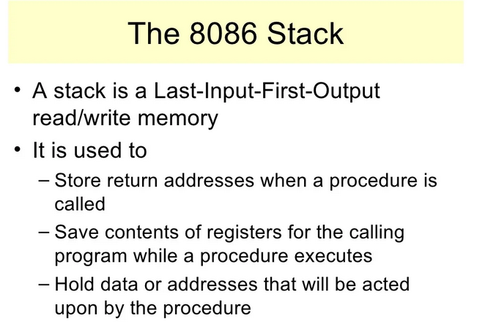

Slide 20
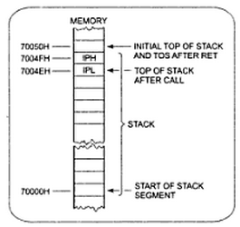
The 8086 Stack
Section of memory you set aside for storing return addresses.
Also used to store the contents of the registers for the calling program while a procedure executes.
Hold data or address that will be acted upon by procedures.

Slide 21
Using PUSH and POP
The PUSH register/memory instruction decrements the stack pointer by 2 and copies he contents of the specified 16-bit register or memory location to memory at the new top-of-stack location.
The POP register/memory instruction copies the word on the top-of-stack to the specified 16-bit register or memory location and increments the stack pointer by 2.

Slide 22
Passing parameters to and from procedures
Major ways of passing parameters to and from a procedure:
In register
In dedicated memory locations accessed by name
With pointers passed in registers
With the stack

Slide 23
Writing and debugging programs containing procedures
Carefully workout the overall structure of the program and break it down into modules which can easily be written as procedures.
Simulate each procedure with few instructions which simply pass test values to the mainline program. This is called as dummy or stubs.
Check that number of PUSH and POP operations are same.
Use breakpoints before CALL, RET and start of the program or any key points in the program.

Slide 24
Reentrant and Recursive procedures
Reentrant procedures: The procedure which can be interrupted, used and “reentered” without losing or writing over anything.
Recursive procedure: It is the procedure which call itself.

Slide 25
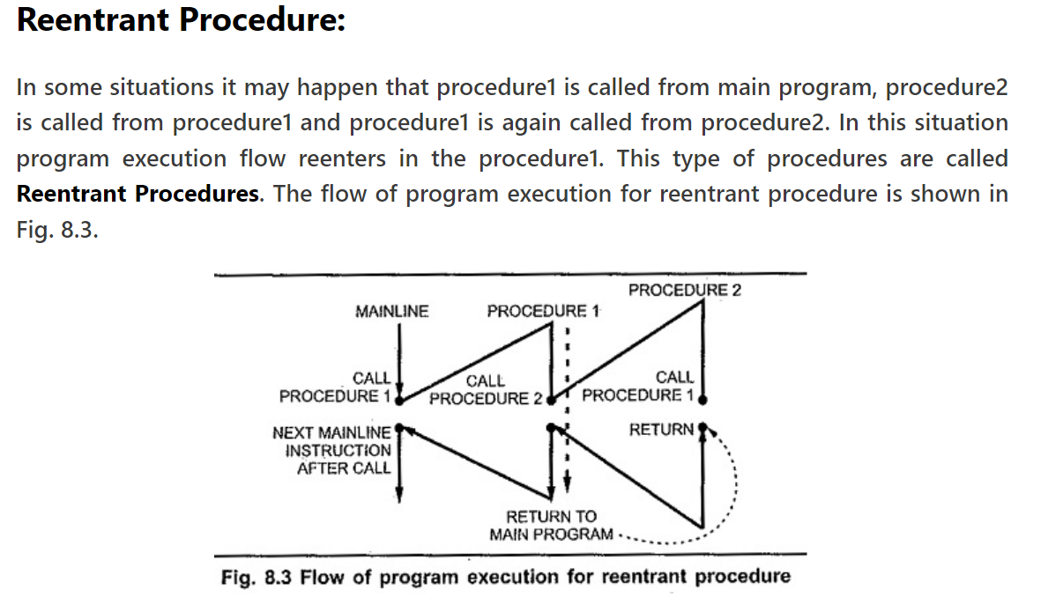

Slide 26
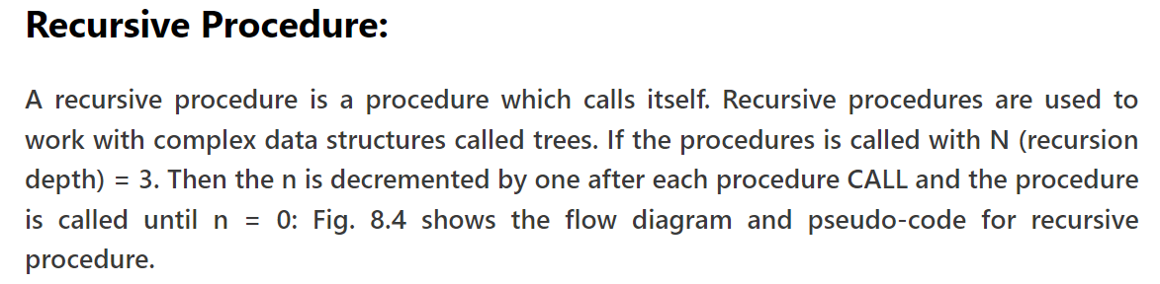
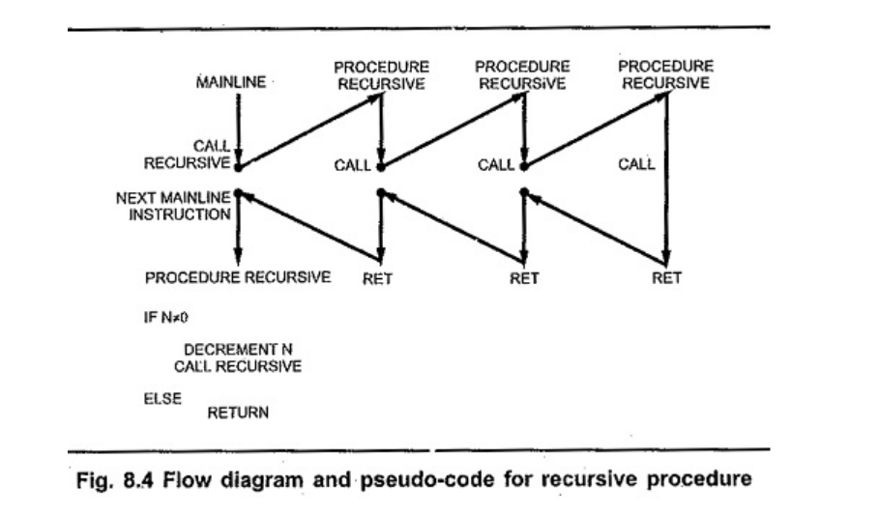

Slide 27
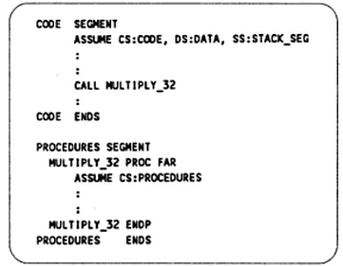
Writing and Calling Far procedures
It is the procedure that is located in a segment which has different name from the segment containing the CALL instruction.

Slide 28
Accessing Procedure
Accessing a procedure in another segment
Put mainline program in one segment and all the procedures in different segment.
Using FAR calls the procedures can accessed as discuss above.
Accessing procedure and data in separate assembly module
Divide the program in the series of module.
The object code files of each module can be linked together.
In the module where variables or procedures are declared, you must use PUBLIC directive to let the linker know that it can be accessed from other modules.
In a module which calls procedure or accesses a variable in another module, you must use the EXTERN directive.

Slide 29
Writing and using Assembler Macros

Slide 30
Comparison Macros and Procedures
A big advantage of using procedures is that the machine codes for the group of instruction in the procedures needs to be loaded in to main memory only once.
Disadvantage using the procedures is the need for the stack.
A macro is the group of instruction we bracket and give a name to at the start of the program.
Using macro avoids the overhead time involved in calling and returning from a procedures.
Disadvantage is that this will make the program take up more memory than using a procedure.

Slide 31
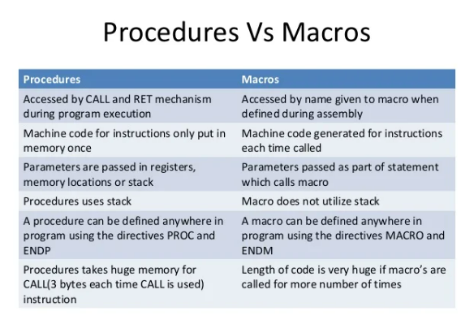

Slide 32
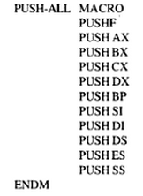
Defining and calling a Macro without parameters

Slide 33
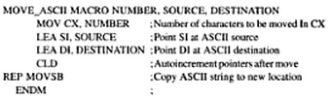
Passing parameters to Macros
The words NUMBER, SOURCE and DESTINATION are called as the dummy variables. When we call the macro, values from the calling statements will be put in the instruction in place of the dummies.

Slide 34
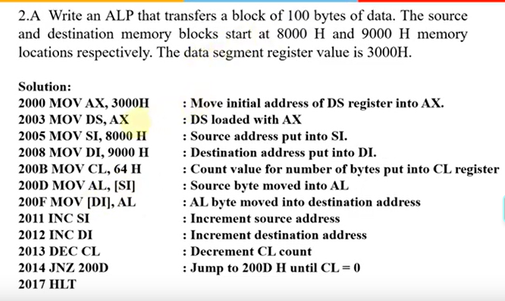

Slide 35
Assembler Directives
Definition: Assembler directives are the instructions used by the assembler at the time of assembling a source program.
Assembler directives are the commands or instructions that control the operation of the assembler.
Assembler directives are the instructions provided to the assembler, not the processor as the processor has nothing to do with these instructions.
These instructions are also known as pseudo-instructions or pseudo-opcode.

Slide 36
Assembler directives:
show the beginning and end of a program provided to the assembler.
used to provide storage locations to data.
used to give values to variables.
define the start and end of different segments, procedures or macros etc. of a program.

Slide 37
An assembler supports directives to define data, to organize segments to control procedure, to define macros.
It consists of two types of statements: instructions and directives.
The instructions are translated to the machine code by the assembler whereas directives are not translated to the machine codes

Slide 38
In assembly language programming
The instructions are specified in the form of mnemonics rather in the form of machine code i.e., 0 and 1.
But the microprocessor or microcontrollers are specifically designed in a way that they can only understand machine language.
Thus assembler is used to convert assembly language into machine code so that it can be understood and executed by the processor.
Therefore, to control the generation of machine codes from the assembly language, assembler directives are used.

Slide 39
Assembler Directives of the 8086 Microprocessor
(a) The DB directive
(b) The DW directive
(c) The DD directive
(d) The STRUCT (or STRUC) and ENDS directives (counted as one)
(e)The EQU Directive
(f)The COMMENT directive
(g)ASSUME
(h) EXTERN
(i) GLOBAL
(j) SEGMENT
(k)OFFSET
(l) PROC
(m)GROUP
(n) INCLUDE

Slide 40
1. DB – The DB directive is used to declare a BYTE type variable – A BYTE is made up of 8 bits.
Declaration examples:
Byte1 DB 10h
Byte2 DB 255 ; 0FFh, the max. possible for a BYTE
2. DW – The DW directive is used to declare a WORD type variable – A WORD occupies 16 bits or (2 BYTE).
Declaration examples:
Word DW 1234h
Word2 DW 65535; 0FFFFh, (the max. possible for a WORD)

Slide 41
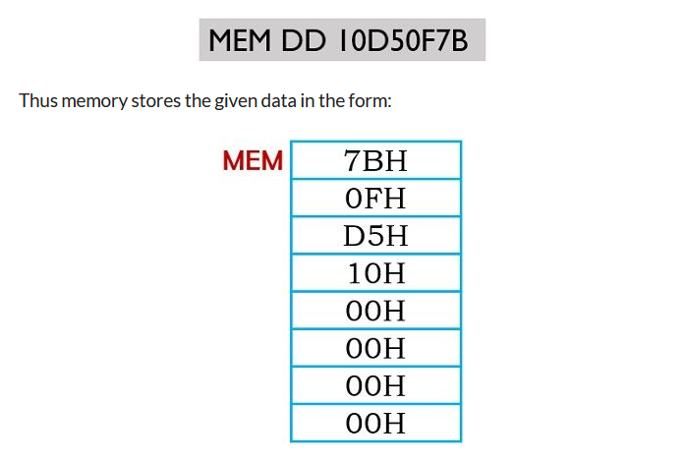
3.DD – The DD directive is used to declare a DWORD – A DWORD double word is made up of 32 bits =2 Word’s or 4 BYTE.
Declaration examples:
Dword1 DW 12345678h
Dword2 DW 4294967295 ;0FFFFFFFFh.

Slide 42
4. STRUCT and ENDS directives to define a structure template for grouping data items.
The STRUCT directive tells the assembler that a user defined uninitialized data structure follows.
The uninitialized data structure consists of a combination of the three supported data types. DB, DW, and DD.
5. The EQU Directive
The EQU directive is used to give name to some value or symbol. Each time the assembler finds the given names in the program, it will replace the name with the value or a symbol
Example:
A – Byte EQU THIS BYTE

Slide 43
6.Extern:
It is used to tell the assembler that the name or label following the directive are I some other assembly module.
For example: if you call a procedure which is in program module assembled at a different time from that which contains the CALL instructions ,you must tell the assembler that the procedure is external the assembler will put information in the object code file so that the linker can connect the two module together.
7. GLOBAL:
The GLOBAL directive can be used in place of PUBLIC directive
For a name defined in the current assembly module; the GLOBAL directive is used to make the symbol available to the other modules.

Slide 44
8.SEGMENT:
It is used to indicate the start of a logical segment. It is the name given to the segment
9.PROC: (PROCEDURE)
It is used to identify the start of a procedure. It follows a name we give the procedure.
After the procedure the term NEAR and FAR is used to specify the procedure Example: SMART-DIVIDE PROC FAR identifies the start of procedure named SMART-DIVIDE and tells the assembler that the procedure is far.
10. NAME:
It is used to give a specific name to each assembly module when program consists of several modules.
Example: PC-BOARD used to name an assembly module which contains the instructions for controlling a printed circuit board.

Slide 45
11. INCLUDE:
It is used to tell the assembler to insert a block of source code from the named file into the current source module. This shortens the source module.
12. OFFSET:
It is an operator which tells the assembler to determine the offset or displacement of a named data item from the start of the segment which contains it. It is used to load the offset of a variable into a register so that variable can be accessed with one of the addressed modes. Example: when the assembler read MOV BX.OFFSET PRICES, it will determine the offset of the prices.
13. GROUP:
It can be used to tell the assembler to group the logical segments named after the directive into one logical group. This allows the contents of all he segments to be accessed from the same group. Example: SMALL-SYSTEM GROUP CODE, DATA, STACK-SEG.

Slide 46
Memory banking in 8086
In any processor , there is memory. This memory is stored in locations. Each location can hold one byte( 8-bits ) of data. Memory banking in 8086 is , having divided the memory into two banks ( two parts ).
Whenever 16-bit data is stored in locations, it is stored in two consecutive memory locations, lower byte is stored in lower address and higher byte is stored in higher address. This concept of lower byte lower location, higher byte in higher location is known as little Endian rule.

Slide 47
Memory Banking:
Here we shall consider an 8086 processor which can hold 1MB of memory due to its 20 address lines ( 2²⁰ = 1MB )
So this 1MB memory is divided into two parts ( two banks ), where one bank consists of all even addresses and the other bank consists of odd addresses.

Slide 48
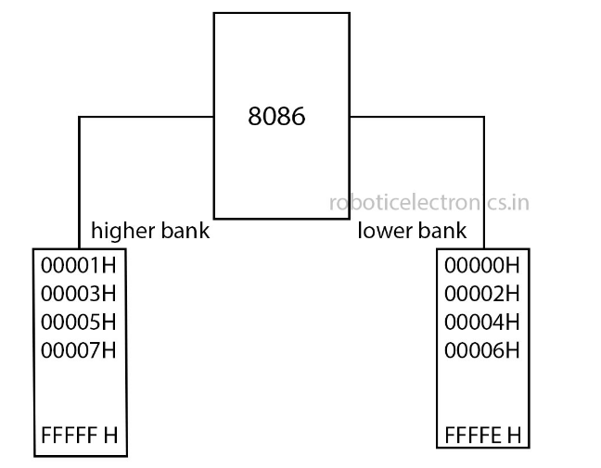
Memory Banking:

Slide 49
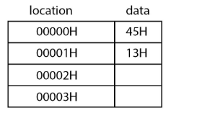
Purpose of memory banking:
As the 16-bit data is stored in 2 locations, lower byte in lower address and upper byte in next consecutive address location.

Slide 50
The data stored here is 1345H. This is representation of data in hexadecimal form. So whenever the processor needs to fetch this , it first gives the address to the address bus and fetches 45H and then it gives the next address, then it fetches 13H. So overall a 16-bit processor needs 2 cycles to perform a 16-bit operation, which is completely a wrong concept. This thing led to memory banking.
If the memory can be divided into two parts, with some algorithm, two 8-bit datas can be fetched in one cycle.
As Even bank starts from 00000_{H} and goes up to FFFFE_{H} , it stores the lower byte so also known as lower bank. Odd bank locations start from 00001_{H} and go upto FFFFF_{H} , this stores higher byte , thus also known as Higher bank in 8086.

